Slide 1

HP CLOUD
HP Stands for Hewlett-Packard

Slide 2
History
HP announced HP Converged Cloud, the industry's first solution that combines private, managed and public clouds with traditional IT to deliver an hybrid approach.
HP Converged Cloud was announced in April 2012. HP Converged Cloud is managed under a Hewlett-Packard business unit established in 2013 named The Converged Cloud unit.
HP Public Cloud was announced on March 14, 2011, and launched as a public beta on May 10, 2012.
The HP Public Cloud Beta went live in May 2012 included OpenStack technology-based storage and content delivery network (CDN) components.
HP Cloud DNS as a Service was moved into general availability on July 1, 2013
On May 7, 2014, HP announced the HP Helion portfolio of products and services, HP Helion includes HP's existing cloud products, new OpenStack technology-based services, and both professional and support services to assist businesses in building and managing hybrid IT environments.

Slide 3
INTRODUCTION
HP Cloud was a set of cloud computing services available from Hewlett-Packard (HP)
HP cloud offered public cloud, private cloud, hybrid cloud, managed private cloud, and other cloud services.
It was the combination of the previous HP Converged Cloud business unit and HP Cloud Services, which is the OpenStack technology-based public cloud.
It is used by enterprise organizations so they can combine public cloud services with their own internal IT resources to create hybrid clouds, or a mix of different cloud computing environments made up of private and public clouds.

Slide 4
Cloud professional services
Companies engage cloud professional services consultants to help them plan how to incorporate cloud services into their business operations. Consultants advise businesses on whether to use public, private, or a hybrid delivery model, and how they should implement or consume those delivery models.For example, cloud professional services consultants might recommend that businesses interested in cost savings place appropriate applications in the public cloud, but keep a higher-security application in a private cloud or Hybrid cloud
The most common reason businesses engage cloud professional services are for assistance with incorporating cloud technology into existing IT environments, and to plan how to implement cloud,

Slide 5
HP Cloud characteristics and components
Converged infrastructure
Open standards
Components
Industry sector packages
(For instance, HP Cloud Services for Airlines integrates Software as a service (SaaS) and infrastructure-as-a-service (IaaS) to the airline industry. Applications for that include HP Passenger Service Solution, which integrates travel and transportation industry applications into a single airline booking and travel SaaS environment.)

Slide 6
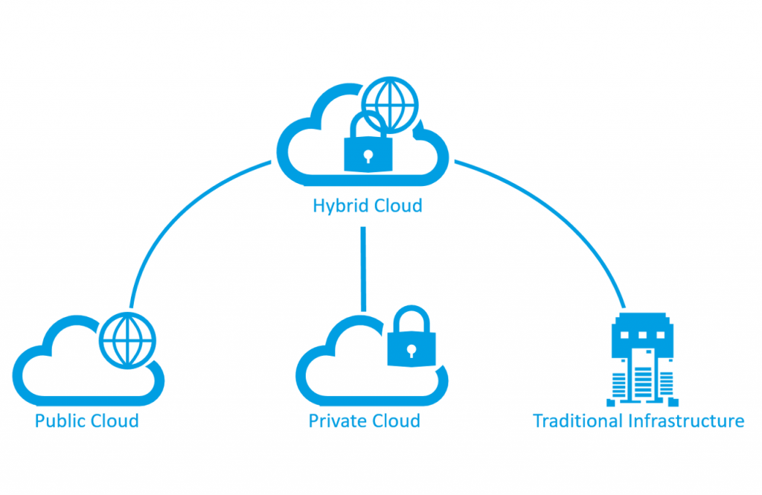
^{CLOUD COMPUTING CHALLENGES}
There can be different types of hybrid clouds for specific tasks:
The Infrastructure as a service (IaaS) model can be a hybrid cloud in that it could use operating systems and virtualization technologies
MIX cloud with public cloud technologies include Platform as a service (PaaS)
infrastructure services combined with development tools and middleware; and Software as a Service (SaaS)
However, moving data in the cloud can be a difficult procedure.
A way to mitigate cloud migration difficulties is to architect applications which select open standards for cloud computing.

Slide 7
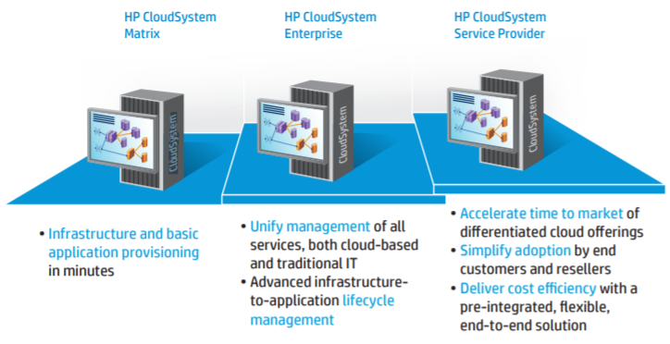
HP CloudSystem has a full range of scalable, extensible offerings to fit any level of cloud maturity.

Slide 8
HP Helion Professional Services
HP Professional Services consultants work with user organizations to help them create cloud environments.
Businesses that engage with HP Professional Services are those that want to use hybrid cloud and other cloud configurations.These businesses receive advice on how they can implement cloud in a consistent manner and how to get value from their cloud investment.
Businesses also receive advice on how to manage the cloud.

Slide 9
HP Helion Professional Services
^{HP Cloud Advisory Services}
^{HP Cloud Strategy Services}
HP Applications Transformation to Cloud Services
^{HP Cloud Design Services}
HP Cloud Implementation Services
^{HP Cloud Operation Services}
^{HP Cloud Education Services}
HP Helion OpenStack Professional Services

Slide 10
HP Helion Managed Virtual Private Cloud
HP Helion Managed Virtual Private Cloud is a managed cloud providing VPC features.
It includes security features for businesses that connect to a public cloud through an on-site network, using Software-defined networking technology.
There are five different sizes of VPC installations.
Businesses can either manage the VPC themselves or pay a fee to have HP manage it.
Businesses that use HP Helion Managed Virtual Private Cloud receive encrypted backup on a daily basis, performed by HP.

Slide 11
HP Public Cloud
HP Public Cloud was a public cloud service from Hewlett-Packard (HP)
Offered compute, storage, and platform services that were accessible via the public Internet to developers, independent software vendors (ISVs), SMBs, and enterprises of all sizes (including public sector).
HP built its cloud infrastructure using OpenStack technology,( an open source cloud infrastructure project, and planned to deliver end-to-end,) converged cloud capabilities (that let users manage their cloud deployments across hybrid, private, managed private, and public cloud delivery models) with HP Public Cloud offering an open, interoperable, intuitive, and reliable public cloud option.

Slide 12

HP Public Cloud Solutions
Cloud professional services help to plan how to incorporate cloud services into their business operations.

Slide 13
HP Public Cloud Solutions
^{Archival as a Service}
^{Backup as a Service}
^{Collaboration as a Service}
PC and Mobile Backup and Synchronization
PC and Mobile Backup and Synchronization
^{Big Data Processing}
Enterprise Application Migration
^{Managing Production Workloads}
Mobile Application Development and Deployment
^{Test & Development solution}
^{Database Archiving}
^{Bursting to the HP Cloud}

Slide 14

CLOUD PRODUCTS
Cloud products are solution that can deliver a virtual server on demand.

Slide 15
CLOUD PRODUCTS
^{HP Cloud Compute}
^{HP Cloud Object Storage}
HP Cloud Content Delivery Network (CDN)
^{HP Cloud Block Storage}
^{HP Cloud Relational Database}
^{HP Cloud Load Balancers}
^{HP Cloud DNS}
^{HP Cloud Monitoring}
HP Cloud Application Platform as a Service

Slide 16
CONCLUSION
HP Cloud was a public cloud service from Hewlett-Packard (HP) that offered compute, storage, and platform services that were accessible via the public Internet to developers, independent software vendors (ISVs), SMBs, and enterprises of all sizes (including public sector).
HP built its cloud infrastructure using OpenStack technology, an open source cloud infrastructure project, and planned to deliver end-to-end, converged cloud capabilities that let users manage their cloud deployments across hybrid, private, managed private, and public cloud delivery models with HP Public Cloud offering an open, interoperable, intuitive, and reliable public cloud option

Slide 17

Thanks!
UZMA SIDDIQUI
ROLL NO:15
MSC(IT)

